Slide 1

AceMind: An AI-Powered Study Companion
Team Members:

Slide 2
Introduction: Navigating Academic Challenges
Academic success hinges on effective time management and clear conceptual understanding. Yet, students frequently grapple with:
Overwhelming exam preparation.
Difficulty with complex topics.
Persistent procrastination.
AceMind integrates intelligent planning with AI-driven explanations to transform the study experience.

Slide 3
Limitations of Existing Study Tools
Current market solutions often address only a fraction of students' needs, leading to a fragmented and inefficient study process.
Tool
Planner
Explainer
Adaptive
Unified Platform
Socratic (Google)
❌
✅
❌
❌
Quizlet AI
❌
✅
❌
❌
MyStudyLife
✅
❌
❌
❌
Feyn
❌
✅
❌
❌
AceMind
✅
✅
✅
✅

Slide 4





Disadvantages of Fragmented Solutions
No Unified Platform
Single-Function Focus
1
Students juggle multiple apps, hindering efficiency.
Limited to either planning or explanation, not both.
5
Static Schedules
2
Lack adaptive progress tracking and real-time adjustments.
Low Engagement
4
Weak motivational tools and limited interactivity.
Disjointed Explanations
3
AI explanations not integrated with study plans.

Slide 5
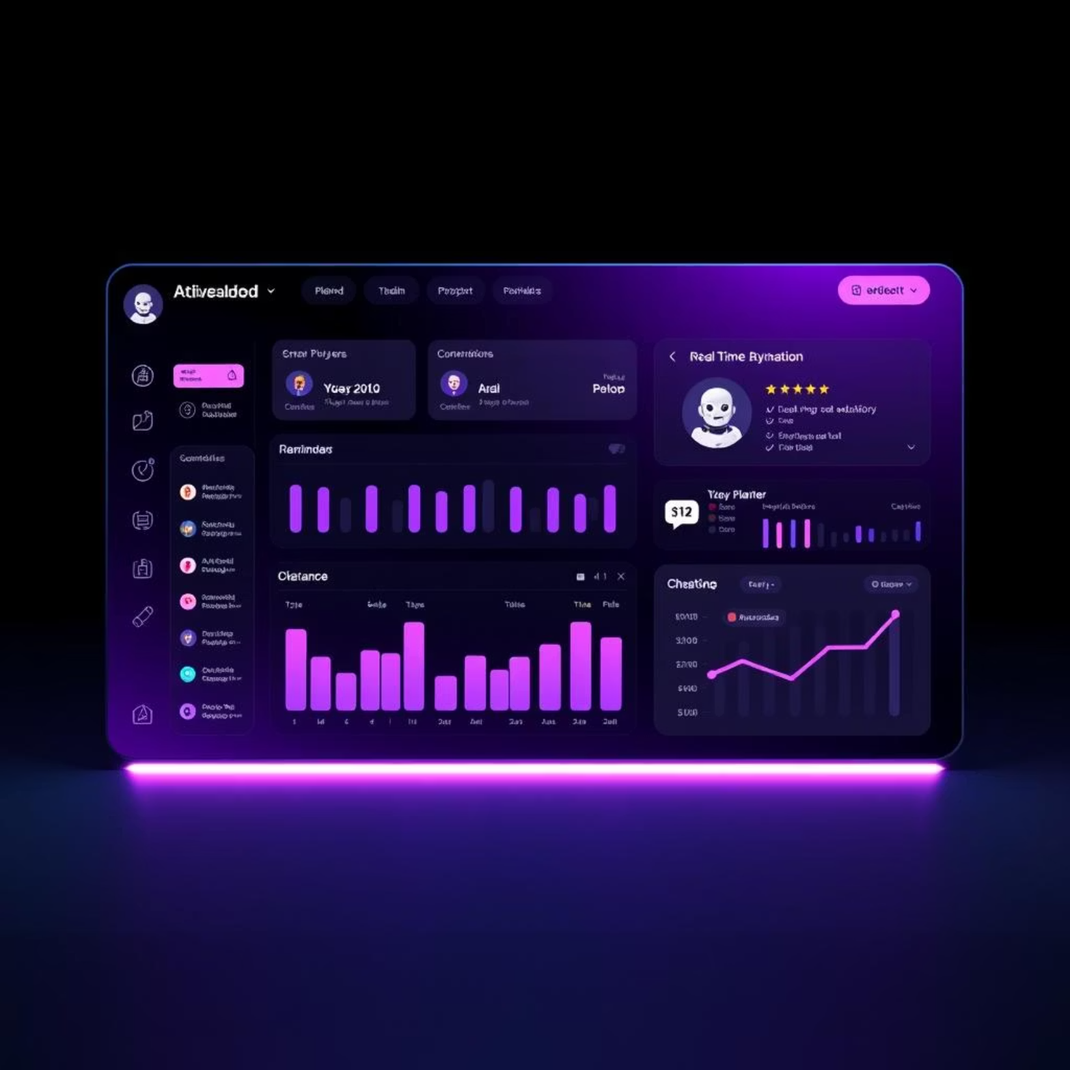
AceMind: The Integrated Solution
AceMind revolutionizes studying by combining:
AI Study Planner: Dynamic and responsive scheduling.
AI Topic Explainer: Contextual and clear learning.
It provides a unified dashboard with real-time adjustments, reminders, and progress tracking, adaptable for all academic levels.

Slide 6





Key Features & Advantages
Personalized Adaptive Schedules
Optimized study plans that adjust to individual progress.
Context-Aware AI Explanations
AI provides clarity directly related to your current study topics and plan.
Real-Time Reminders & Dashboards
Stay on track with timely notifications and progress visualizations.
Reduces Stress & Procrastination
Fosters a more organized and motivated learning environment.
Broader Applicability
Suitable for school, college, and professional exam preparation.

Slide 7
AceMind: Methodology & Algorithm
Input Data
Exam dates & deadlines
Topic Explainer (LLMs)
Subject areas & topics
Conversational query handling
Daily availability & preferences
Contextual & personalized explanations
1
2
3
4
Planner Algorithm
Tech Stack
Prioritization logic
Frontend: HTML/CSS/JS
Adaptive rescheduling
Backend: Python
Optimized time allocation
Database: MongoDB
AI: Large Language Models

Slide 8
Transforming Education with AI
"AceMind bridges the gap between fragmented study tools, offering a truly unified and intelligent learning experience."
By unifying planning and explanation, AceMind enables efficient, stress-free, and personalized learning:
Improved time management
Faster conceptual clarity
Higher academic productivity
This project showcases the profound potential of AI to revolutionize educational paradigms.

Slide 9



A Vision for the Future of Learning
AceMind is more than just an app; it's a commitment to empowering students with the tools they need to succeed in an increasingly complex academic landscape. We believe in:
Personalized Paths
Tailoring education to individual needs and styles.
Student Empowerment
Giving learners control over their academic journey.
Continuous Innovation
Leveraging cutting-edge AI for smarter study solutions.

Slide 10
Thank You

